Slide 1
INFORMATION SECURITY
Cryptography

Slide 2
Cryptography
Cryptography or “secret codes” are a fundamental information security tool.
Cryptology ⎯ The art and science of making and breaking “secret codes”
Cryptography ⎯ making “secret codes”
Cryptanalysis ⎯ breaking “secret codes”

Slide 3
Terminology
Plaintext original message
Ciphertext encrypted or coded message
Encryption convert from plaintext to ciphertext (enciphering)
Decryption restore the plaintext from ciphertext (deciphering)
Key information used in cipher known only to sender/receiver
Cipher a particular algorithm (cryptographic system)
Cryptography study of algorithms used for encryption
Cryptanalysis study of techniques for decryption without knowledge of plaintext
Cryptology cryptography + cryptanalysis

Slide 4
Cryptographic Objectives
CIA == Confidentiality, Integrity, and Availability
Confidentiality
aims to prevent unauthorized reading of information.
Integrity
detect unauthorized writing of information
Availability
Data is available in a timely manner when needed

Slide 5
How to Speak Crypto
A cipher or cryptosystem is used to encrypt the plaintext
The result of encryption is ciphertext
We decrypt ciphertext to recover plaintext
A key is used to configure a cryptosystem
A symmetric key cryptosystem uses the same key to encrypt as to decrypt
A public key (Asymmetric key) cryptosystem uses a public key to encrypt and a private key to decrypt

Slide 6
Symmetric key
key
key
plaintext
encrypt
decrypt
plaintext
ciphertext
A generic view of symmetric key crypto

Slide 7
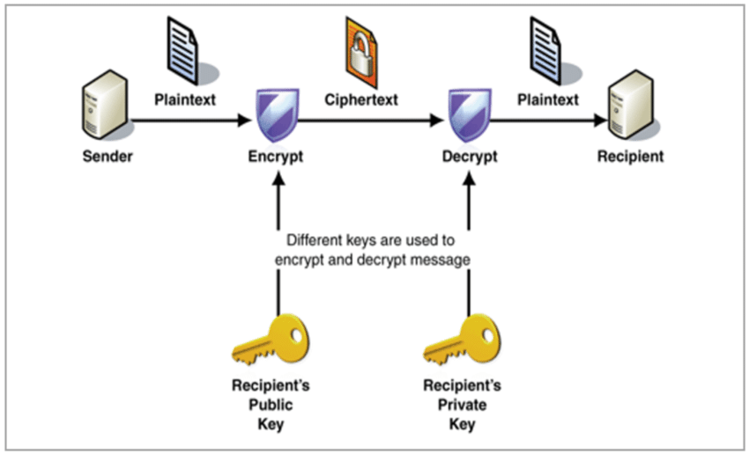
public key

Slide 8
Crypto
Basic assumptions
The system is completely known to the attacker
Only the key is secret
That is, crypto algorithms are not secret
This is known as Kerckhoffs’ Principle

Slide 9
Classic cryptosystems
We’ll examine different classic cryptosystems each of which illustrates some particularly relevant feature:
Simple Substitution cipher
double transposition cipher
Playfair cipher
One time pad cipher
Vigenere Cipher
Affine Cipher
Hill Cipher

Slide 10
Simple Substitution Cipher
The message is encrypted by substituting the letter of the alphabet n places ahead of the current letter.
For example, with n = 3, the substitution—which acts as the key is:
Plaintext
a | b | c | d | e | f | g | h | i | j | k | l | m | n | o | p | q | r | s | t | u | v | w | x | y
D | E | F | G | H | I | J | K | L | M | N | O | P | Q | R | S | T | U | V | W | X | Y | Z | A | B
z
C
Ciphertext
where we’ve followed the convention that the plaintext is lowercase and the ciphertext is uppercase.
Notes:
symmetric

Slide 11
Simple Substitution
Plaintext: fourscoreandsevenyearsago
Key:
Plaintext
a | b | c | d | e | f | g | h | i | j | k | l | m | n | o | p | q | r | s | t | u | v | w | x | y
D | E | F | G | H | I | J | K | L | M | N | O | P | Q | R | S | T | U | V | W | X | Y | Z | A | B
z
C
Ciphertext
Ciphertext:
IRXUVFRUHDQGVHYHQBHDUVDJR
Shift by 3 is “Caesar’s cipher”

Slide 12
Ceasar’s Cipher
For each plaintext letter p, substitute the ciphertext letter C:
C = E(3, p) = (p + 3) mod 26
A shift may be of any amount, so that the general Caesar algorithm is
C = E(k, p) = (p + k) mod 26

Slide 13
Ceasar’s Cipher Decryption
Suppose we know a Caesar’s cipher is being used:
Given ciphertext:
VSRQJHEREVTXDUHSDWV
a | b | c | d | e | f | g | h | i | j | k | l | m | n | o | p | q | r | s | t | u | v | w | x | y
D | E | F | G | H | I | J | K | L | M | N | O | P | Q | R | S | T | U | V | W | X | Y | Z | A | B
z
C
Plaintext
Ciphertext
Plaintext: spongebobsquarepants
Notes:
by looking up each letter in the plaintext row and substituting the corresponding letter in the ciphertext row or by simply replacing each letter by the letter that is three positions ahead of it in the alphabet.

Slide 14
Cryptanalysis
If we limit the simple substitution to shifts, then the possible keys are n ∈ {0, 1, 2, . . . , 25}.
A simple substitution (shift by n) is used
But the key is unknown
Given ciphertext: CSYEVIXIVQMREXIH
How to find the key?
Only 26 possible keys ⎯ try them all!

Slide 15
Cryptanalysis
decrypting the message with each putative key and checking whether the resulting putative plaintext looks like sensible plaintext.
The brute force approach of trying all possible keys until we stumble across the correct one is known as an exhaustive key search.
it’s necessary (although far from sufficient) that the number of possible keys be too large to simply try them all in any reasonable amount of time.

Slide 16
Simple Substitution: General Case
The simple substitution cipher need not be limited to shifting by n.
In general, simple substitution key can be any permutation of letters
Not necessarily a shift of the alphabet
For example
Plaintext
a | b | c | d | e | f | g | h | i | j | k | l | m | n | o | p | q | r | s | t | u | v | w | x | y
J | I | C | A | X | S | E | Y | V | D | K | W | B | Q | T | Z | R | H | F | M | P | N | U | L | G
z
O
Ciphertext
Then 26! > 2⁸⁸ possible keys

Slide 17
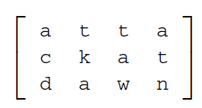
Double Transposition Cipher
To encrypt with a double transposition cipher, we first write the plaintext into an array of a given size and then permute the rows and columns according to specified permutations.
For example, suppose we write the plaintext attackatdawn into a 3 × 4 array:

Slide 18
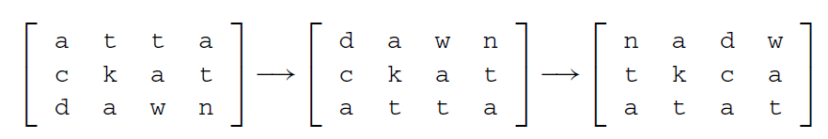
Double Transposition Cipher
Now if we transpose (or permute) the rows according to (1, 2, 3) → (3, 2, 1) and then transpose the columns according to (1, 2, 3, 4) → (4, 2, 1, 3), we obtain:

Slide 19
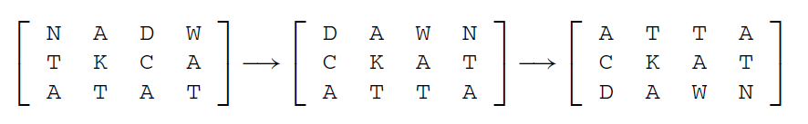
Double Transposition Cipher
For the double transposition, the key consists of the size of the matrix and the row and column permutations.
For example, to decrypt pervious ciphertext is first put into a 3 × 4 array.
Then the columns are numbered as (4, 2, 1, 3) and rearranged to (1, 2, 3, 4).
Then the rows are numbered (3, 2, 1) and rearranged into (1, 2, 3), as illustrated below

Slide 20

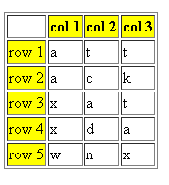
Double Transposition Cipher

Slide 21
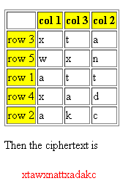
Double Transposition Cipher

Slide 22
PROBLEM
Encrypt the message
we are all together
using a double transposition cipher with 4 rows and 4 columns, using the row permutation
(1, 2, 3, 4) → (2, 4, 1, 3)
and the column permutation
(1, 2, 3, 4) → (3, 1, 2, 4).

Slide 23
Playfair Cipher
The best-known multiple-letter encryption cipher is the Playfair.
The Playfair algorithm is based on the use of a 5 x 5 matrix of letters constructed using a keyword.
If the keyword is monarchy. The matrix is constructed by filling in the letters of the keyword (minus duplicates) from left to right and from top to bottom, and then filling in the remainder of the matrix with the remaining letters in alphabetic order. The letters I and J count as one letter.

Slide 24
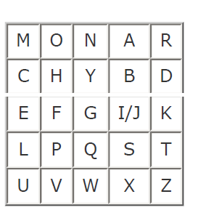
Playfair Cipher

Slide 25
Playfair Cipher
Plaintext is encrypted two letters at a time, according to the following rules:
Repeating plaintext letters that are in the same pair are separated with a filler letter, such as x, so that balloon would be treated as ba lx lo on.
Two plaintext letters that fall in the same row of the matrix Shift Right. For example, ar is encrypted as RM.

Slide 26
Playfair Cipher
Two plaintext letters that fall in the same column Shift Down. For example, mu is encrypted as CM.
Otherwise, each plaintext letter in a pair is replaced by the letter that lies in its own row and the column occupied by the other plaintext letter. Thus, hs becomes BP and ea becomes IM

Slide 27
Playfair Cipher: Example Encryption
Plaintext: Balloon
Key: monarchy
Encryption
BA: IB
LX: SU
LO: PM
ON: NA
Ciphertext: IBSUPMNA

Slide 28
Playfair Cipher: Example Decryption
Ciphertext: IBSUPMNA
Decryption
Same row: shift Left
Same column: shift up
Difference: intersection
IB: BA
SU: LX
PM: LO
NA: ON

Slide 29
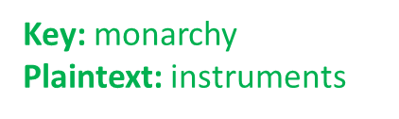
Playfair Cipher: Example 2 Encryption
The plaintext is split into pairs of two letters (digraphs). If there is an odd number of letters, a Z is added to the last letter.
PlainText: "instruments"
After Split: 'in' 'st' 'ru' 'me' 'nt' 'sz'

Slide 30
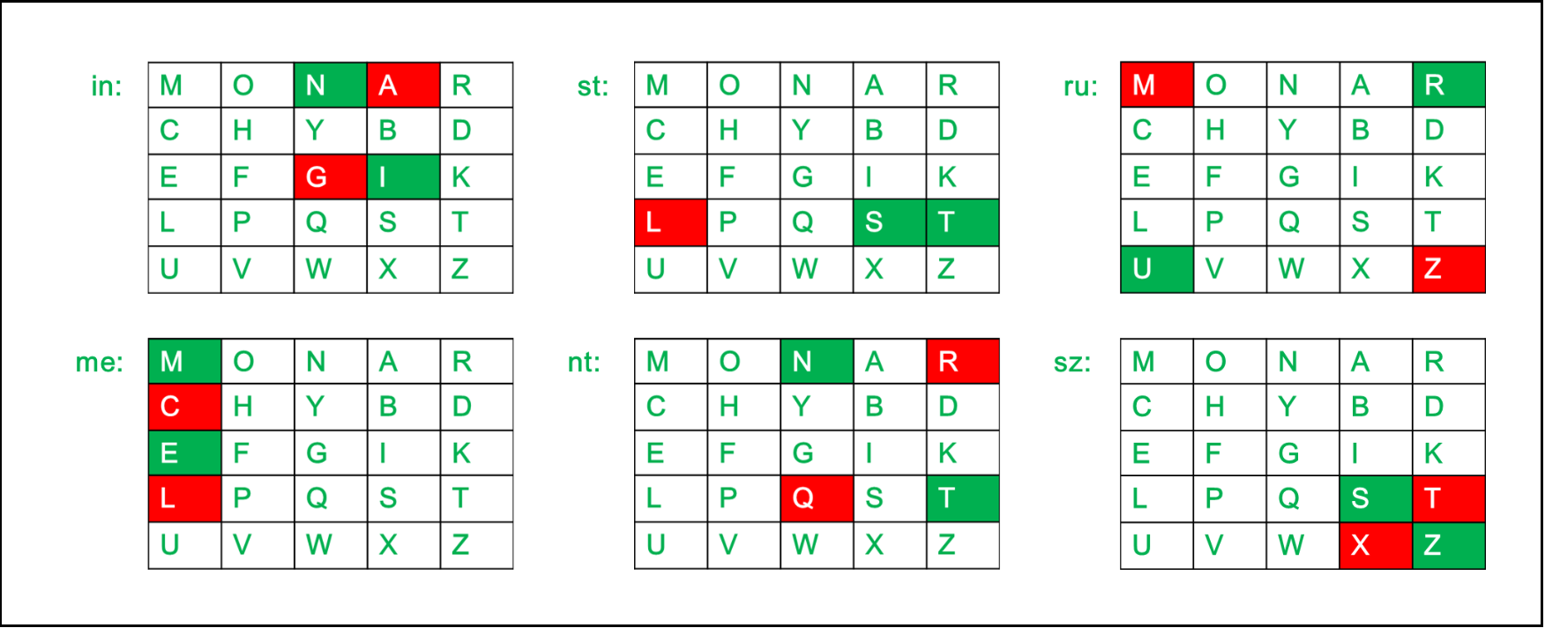
Playfair Cipher: Example 2 Encryption

Slide 31
Playfair Cipher: Example 2 Encryption
Plain Text: "instrumentsz"
Encrypted Text: gatlmzclrqtx
Encryption:
i -> g
n -> a
s -> t
t -> l
r -> m
u -> z
m -> c
e -> l
n -> r
t -> q
s -> t
z -> x

Slide 32
Playfair Cipher: Example 2 Decryption

Slide 33
Playfair Cipher: Example 2 Decryption
Plain Text: "gatlmzclrqtx"
Decrypted Text: instrumentsz
Decryption:
(red)-> (green)
ga -> in
tl -> st
mz -> ru
cl -> me
rq -> nt
tx -> sz

Slide 34
Playfair Cipher Drawback
The main drawback of the Playfair cipher is that:
The plaintext can consist of 25 uppercase letters only. One letter has to be omitted and cannot be reconstructed after decryption.
Also lowercase letters, white space, numbers and other printable characters cannot be handled by the traditional cipher. This means that complete sentences cannot be handled by this cipher.
Space between two words in the plaintext is not considered as one character.
A spare letter X is added when the plaintext word consists of odd number of character. In the decryption process this X is ignored. X is a valid character and creates confusion because it could be a part of plaintext, so we cannot simply remove X in decryption process.

